Slide 1
Intro to LoRa
Kukuh Satrio Wibowo

Slide 2
What is LoRa?
LoRa (short for long range) is a spread spectrum modulation technique derived from chirp spread spectrum (CSS) technology. Semtech’s LoRa devices and wireless radio frequency technology is a long range, low power wireless platform that has become the de facto technology for Internet of Things (IoT) networks worldwide.
Resource :
https://www.semtech.com/lora/what-is-lora

Slide 3
Tools
Arduino Uno
LoRa Gateway
LoRa Client
DHT11
Soil Mosquiture
LCD 16 X 2
LoRa module RFM95 SX1276

Slide 4
Software
Arduino IDE
Software Defined Radio (SDR) technology LoRa

Slide 5
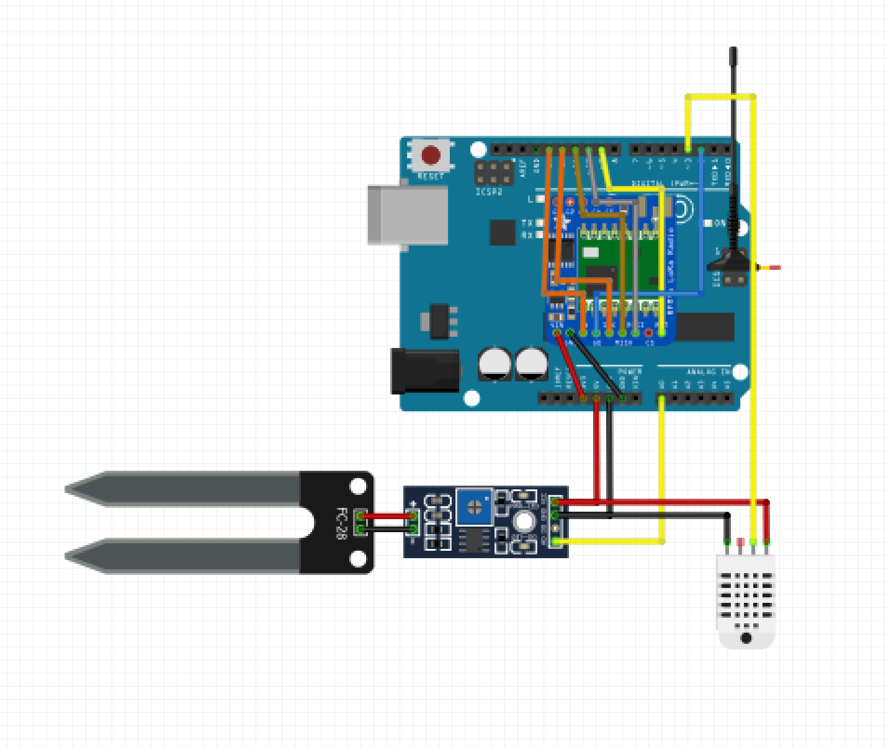
Schematic LoRa Transmiter

Slide 6
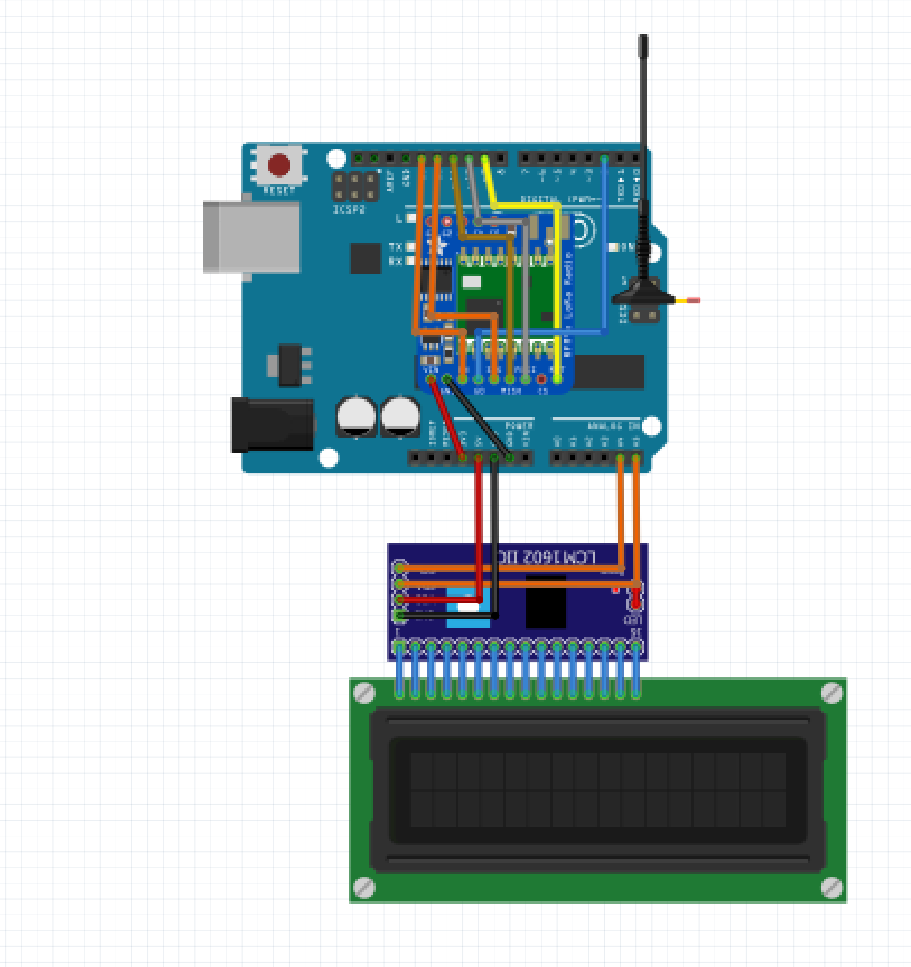
Schematic LoRa Receiver

